Slide 1
Project 3
Heart Disease prediction
Yap Yeong Cherng

Slide 2
Question / Dataset
Heart diseases
Taking an estimated 17.9million lives each year
Can we predict who is likely to have heart failure ?
Provide early health care to possibly prevent or provide early healthcare
https://www.kaggle.com/ronitf/heart-disease-uci
https://www.who.int/health-topics/cardiovascular-diseases#tab=tab_1

Slide 3
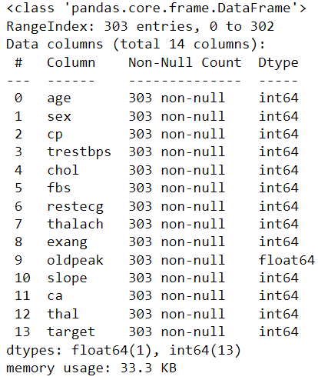
Dataset
age
sex
chest pain type (4 values)
resting blood pressure
serum cholestoral in mg/dl
fasting blood sugar > 120 mg/dl
resting electrocardiographic results (values 0,1,2)
maximum heart rate achieved
exercise induced angina
oldpeak = ST depression induced by exercise relative to rest
the slope of the peak exercise ST segment
number of major vessels (0-3) colored by flourosopy
thal: 3 = normal; 6 = fixed defect; 7 = reversable defect
Target: 0 = no heart disease; 1 = heart disease

Slide 4
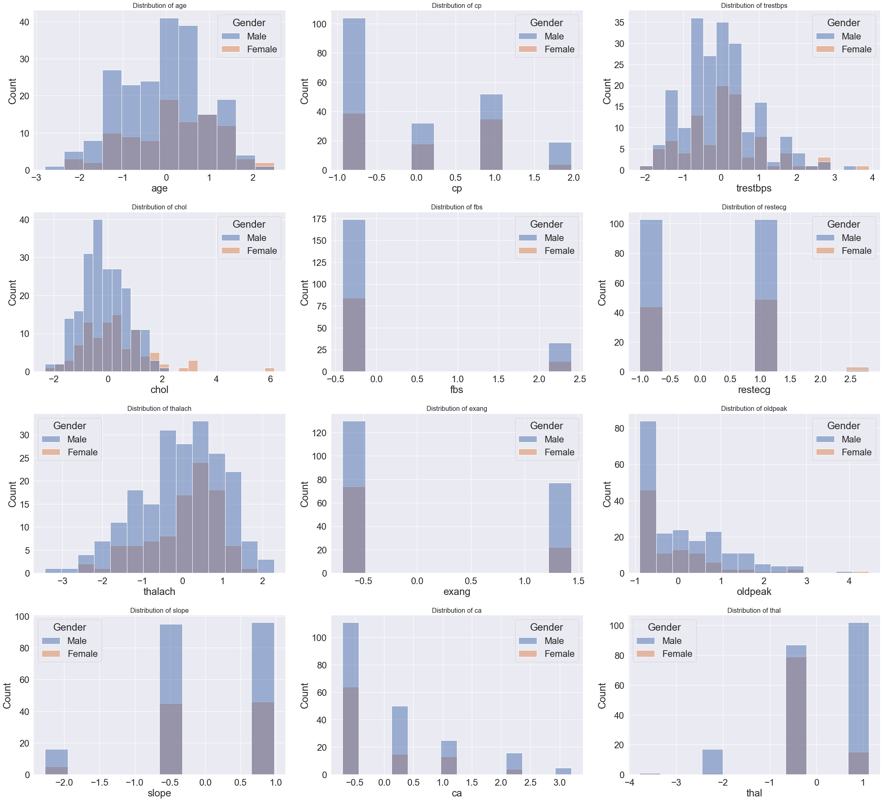
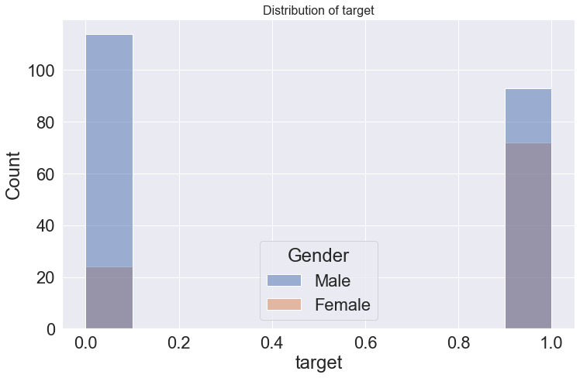
Dataset EDA
Standardscaler used to standardize the data
Males account for most of the patients in this data set
Notes:
In terms of ratio in this dataset, we can see that females have a higher occurrence of heart disease than males

Slide 5
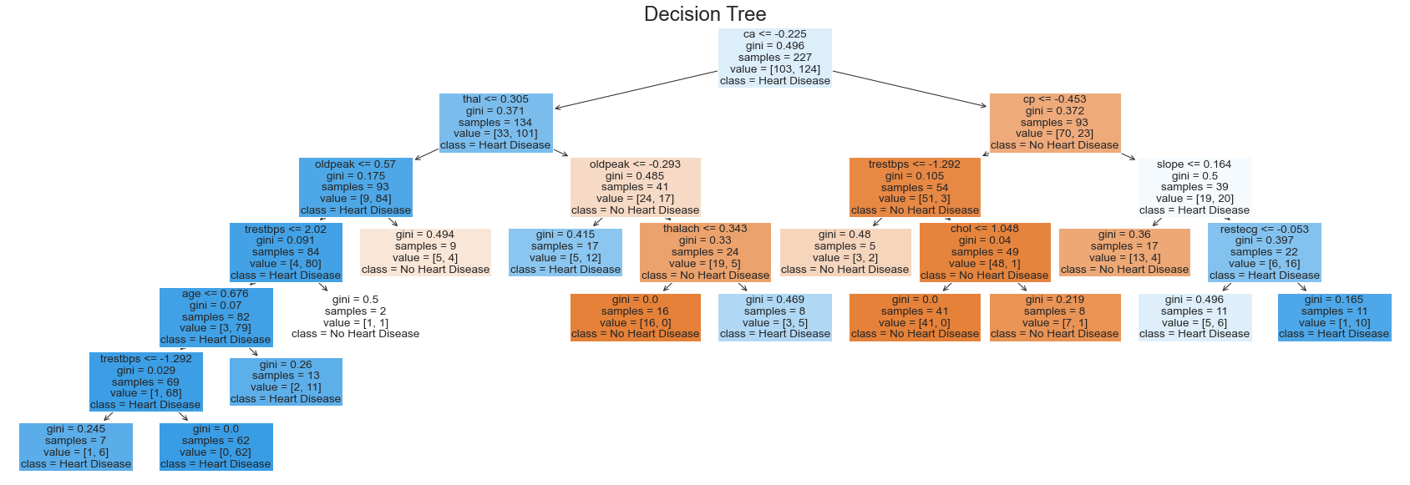
Decision Tree fitting
Accuracy: 0.7895

Slide 6
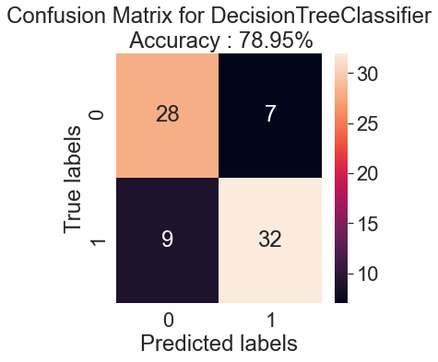
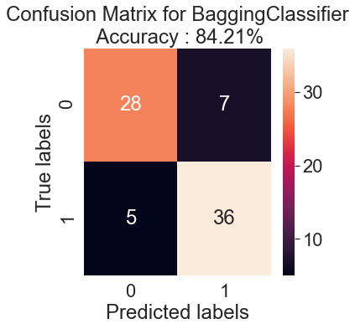
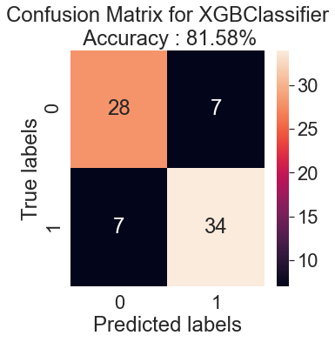
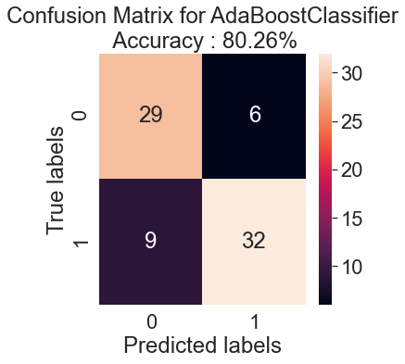
Confusion matrix with other classifiers
Average 81% accuracy
Notes:
TN , FP
FN, TP

Slide 7
Conclusion
With current sample size and current models, an average accuracy of 81%
Larger samples size
Other features
Yearly sample data
Reevaluate / combine models
What’s next to improve model

